Slide 1
Final Project Report
Prajna Gopal Hardikar
7459305747

Slide 2
Final Project Report
Outline
Exploratory Data Analysis Report
Data Preparation Plan
Model Pipeline
Inference Pipeline
Summary Discussion

Slide 3
EDA Report
Outline
Business objective
Dataset summary
Data quality summary
Univariate analysis
Bivariate analysis
Note: Final Project Dataset.csv is split into training and validation dataset with random state=42. Same seed is used in Model pipeline when splitting data. EDA is performed in Tableau only on Training data to avoid data leakage. All decisions are made based on training data only.

Slide 4
EDA Report
Business objective
Develop a model to predict whether the participant developed coronary heart disease (CHD) within 10 years of the examination
Business Impact:
Reduce CHD-related healthcare costs by implementing proactive and preventive measures.
Improve patient outcomes by identifying at-risk individuals early and implementing timely interventions.

Slide 5
EDA Report
Dataset Summary
“Final Project Dataset.csv” – dataset with 19 variables and 3,816 observations
Dataset contains one potential response variables:
Name | Label | Description
TenYearCHD | Ten Year CHD | A binary target variable to indicate whether the participant developed coronary heart disease (CHD) within 10 years of the examination (yes or no) .

Slide 6
Dataset Summary
Demographic Variables
Demographic variables describe the profile of each participant in terms of age, gender, education and income
Name | Label | Description
age | Age | age of the participant at the time of examination
male | Gender | gender of the participant (male =1, female = 0)
education | Education | Educational level of the participant (1 = less than high school, 2 = completed high school or equivalent, 3 = some college, 4= completed college or higher)
income | Income | Income of the participant

Slide 7
Dataset Summary
Categorical Variables
Categorical variables related to the participant’s co-morbidities
Name | Label | Description
currentSmoker | Current Smoker | whether the participant is currently a smoker (yes or no)
BPMeds | BP Meds | whether the participant is taking blood pressure medication (yes or no)
prevalentStroke | Prevalent Stroke | whether the participant has a history of stroke (yes or no)
prevalentHyp | Prevalent Hyp | whether the participant has a history of hypertension (yes or no)
diabetes | Diabetes | whether the participant has diabetes (yes or no)

Slide 8
Dataset Summary
Numeric Variables
Numerical measures related to the participant’s lab results
Name | Label | Description
cigsPerDay | Cigarettes per Day | the average number of cigarettes smoked per day by current smoker
totChol | Total Chol | total cholesterol level in milligrams per deciliter
sysBP | Sys BP | systolic blood pressure in millimeters of mercury
diaBP | Dia BP | diastolic blood pressure in millimeters of mercury
BMI | BMI | body mass index in kilograms per square meter
heartRate | Heart Rate | resting heart rate in beats per minute
glucose | Glucose | Blood glucose level in milligrams per deciliter
a1c | A1c | Hemoglobin A1c (%)

Slide 9
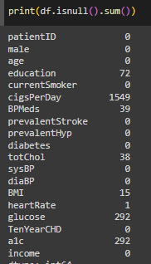
EDA Report
Data Quality Summary
Missing values:
8 variables have missing values:
education
cigsPerDay
BPMeds
totChol
BMI
heartRate
glucose
a1c

Slide 10
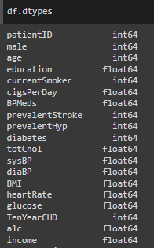
EDA Report
Data Quality Summary
Data types:
All variables are numeric – int/float
Education is treated as a categorical variable as it indicates Educational level of the participant (1 = less than high school, 2 = completed high school or equivalent, 3 = some college, 4= completed college or higher)

Slide 11
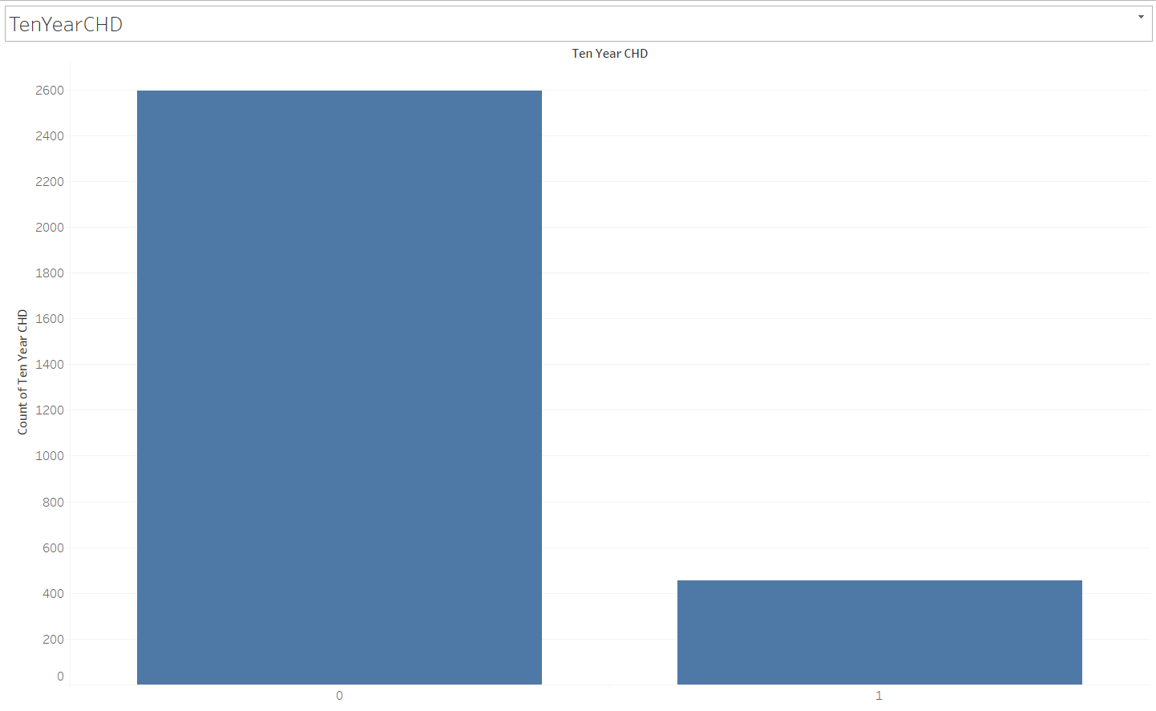
EDA Report – Univariate Analysis
Response Variables
Highly imbalance data. Hence, will perform SMOTE on training data

Slide 12
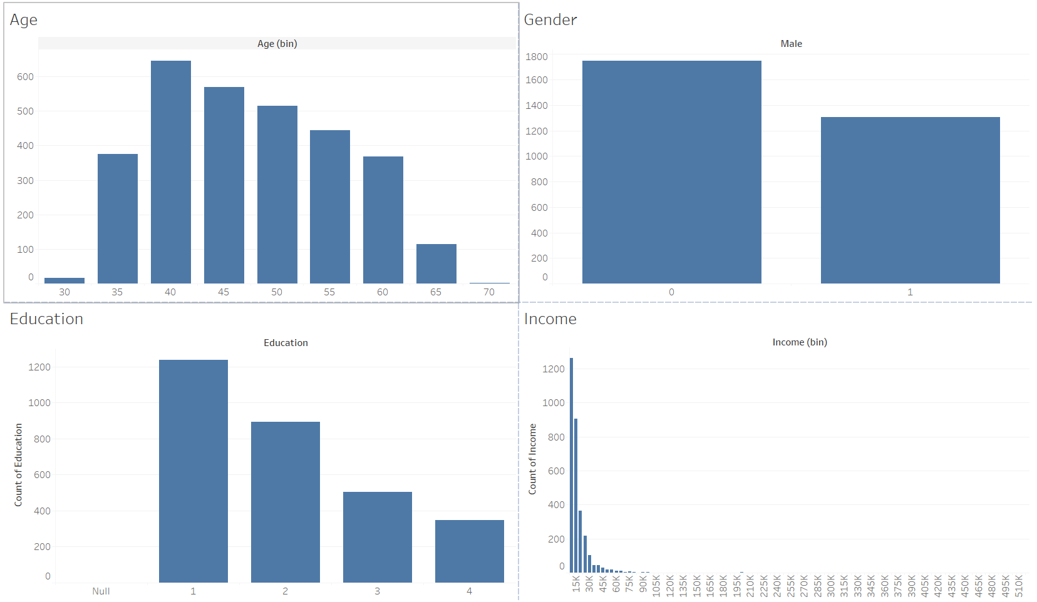
EDA Report – Univariate Analysis
Participant Demographics
Contains null category. Will treat all nulls as 5th category
Strong positive skew. Hence, perform log transformation. Contains outliers.

Slide 13
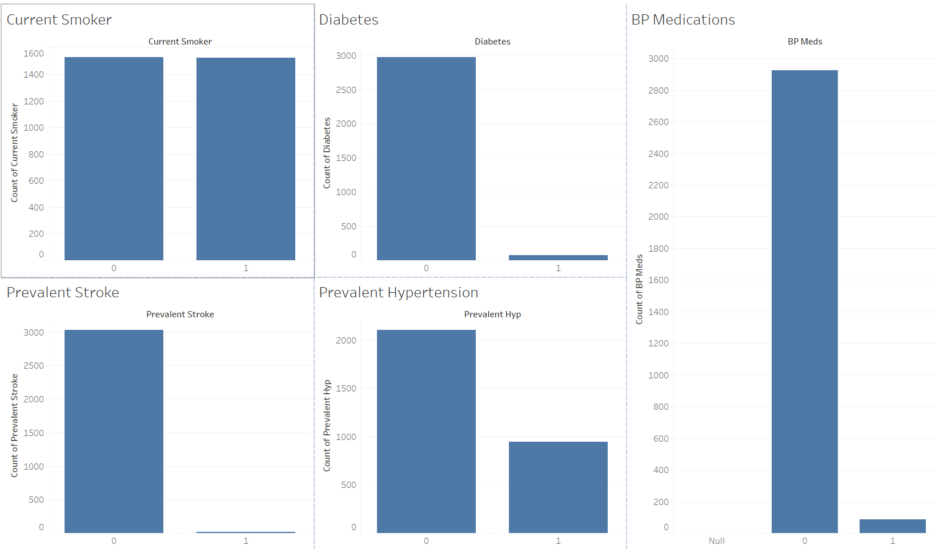
EDA Report – Univariate Analysis
Categorical variables
Diabetes, PrevalentStroke and BP Medications have very less 1’s over 0’s which implies most of the participants don’t have diabetes and prevalent stroke and will not take BP Medicines

Slide 14
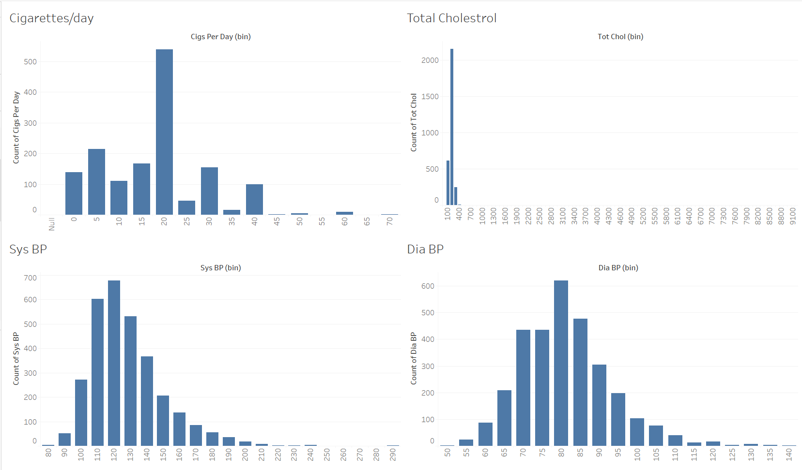
EDA Report – Univariate Analysis
Numeric variables
Contains outliers
Contains heavy outliers
Moderately positive skewed and has outliers

Slide 15
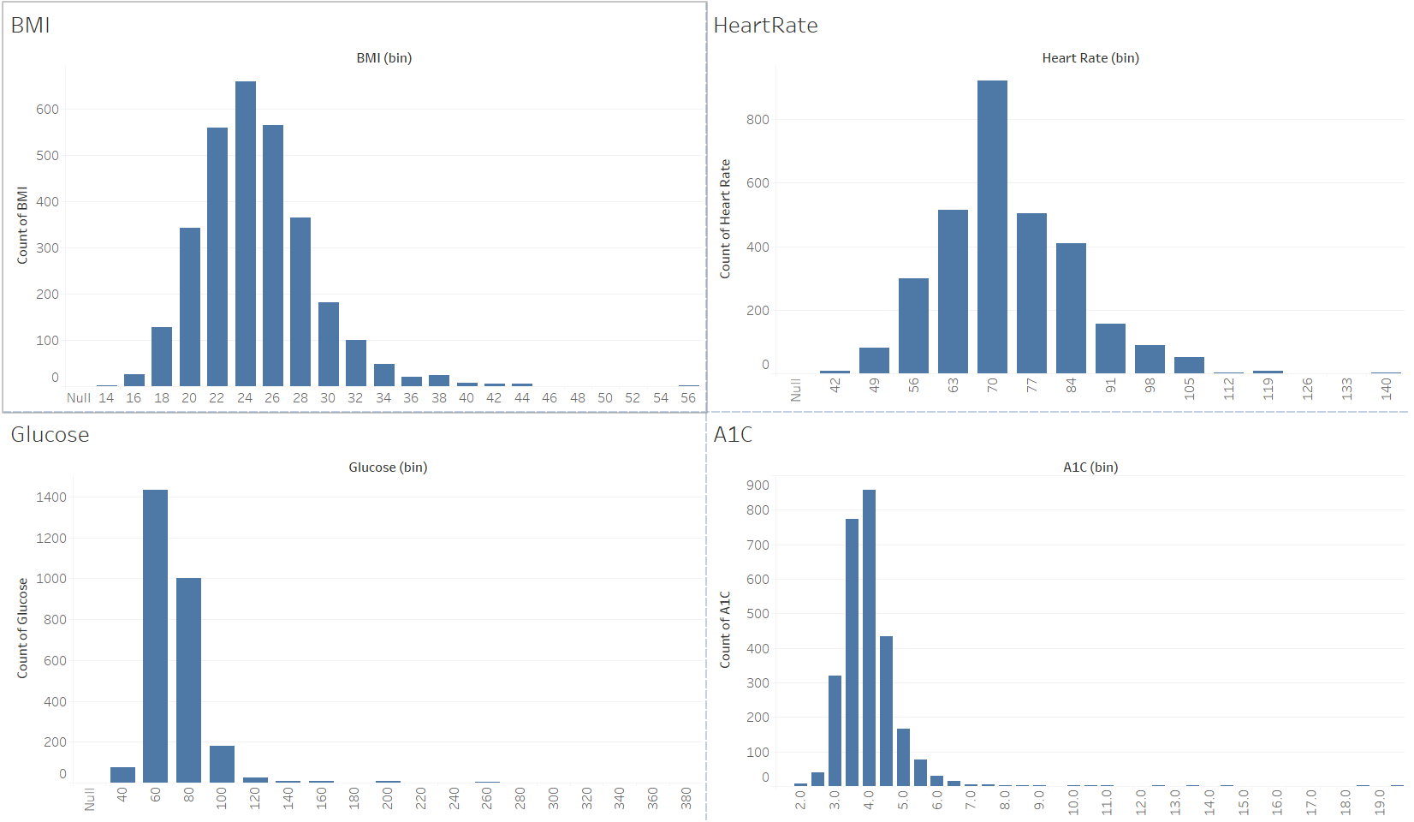
EDA Report – Univariate Analysis
Numeric variables
Contains outliers
Contains heavy outliers. Low positive skew
Contains heavy outliers and low positive skew

Slide 16
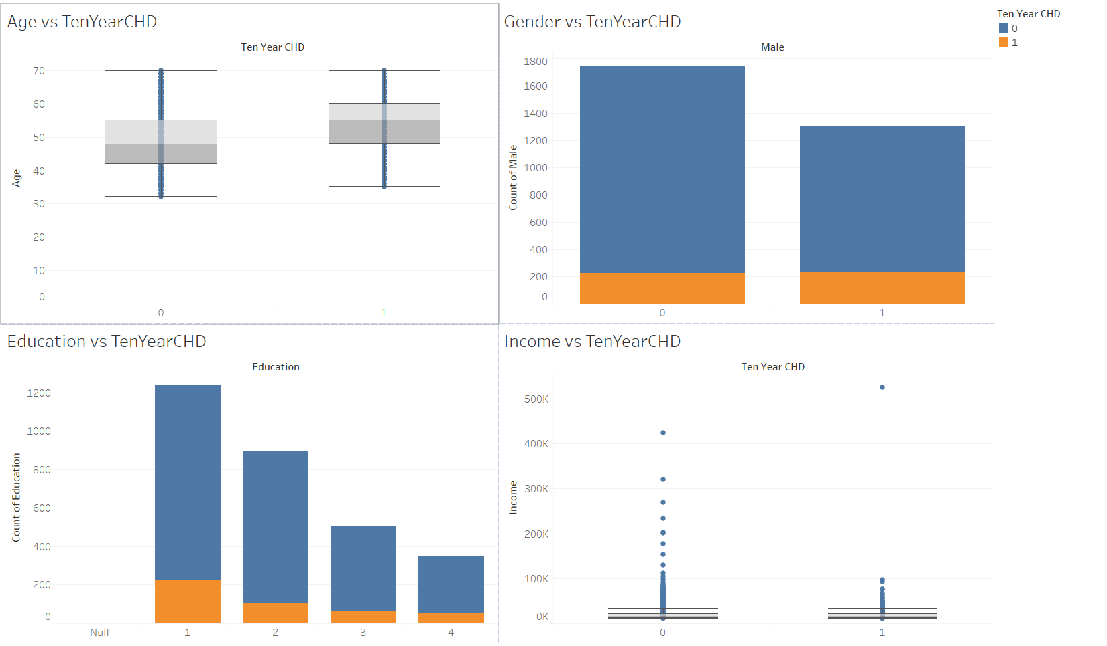
Bivariate Analysis
Demographic vs Response variable
No significant correlation with response variable
Age is lightly correlated with response variable
Heavy outliers and hard to notice correlation

Slide 17
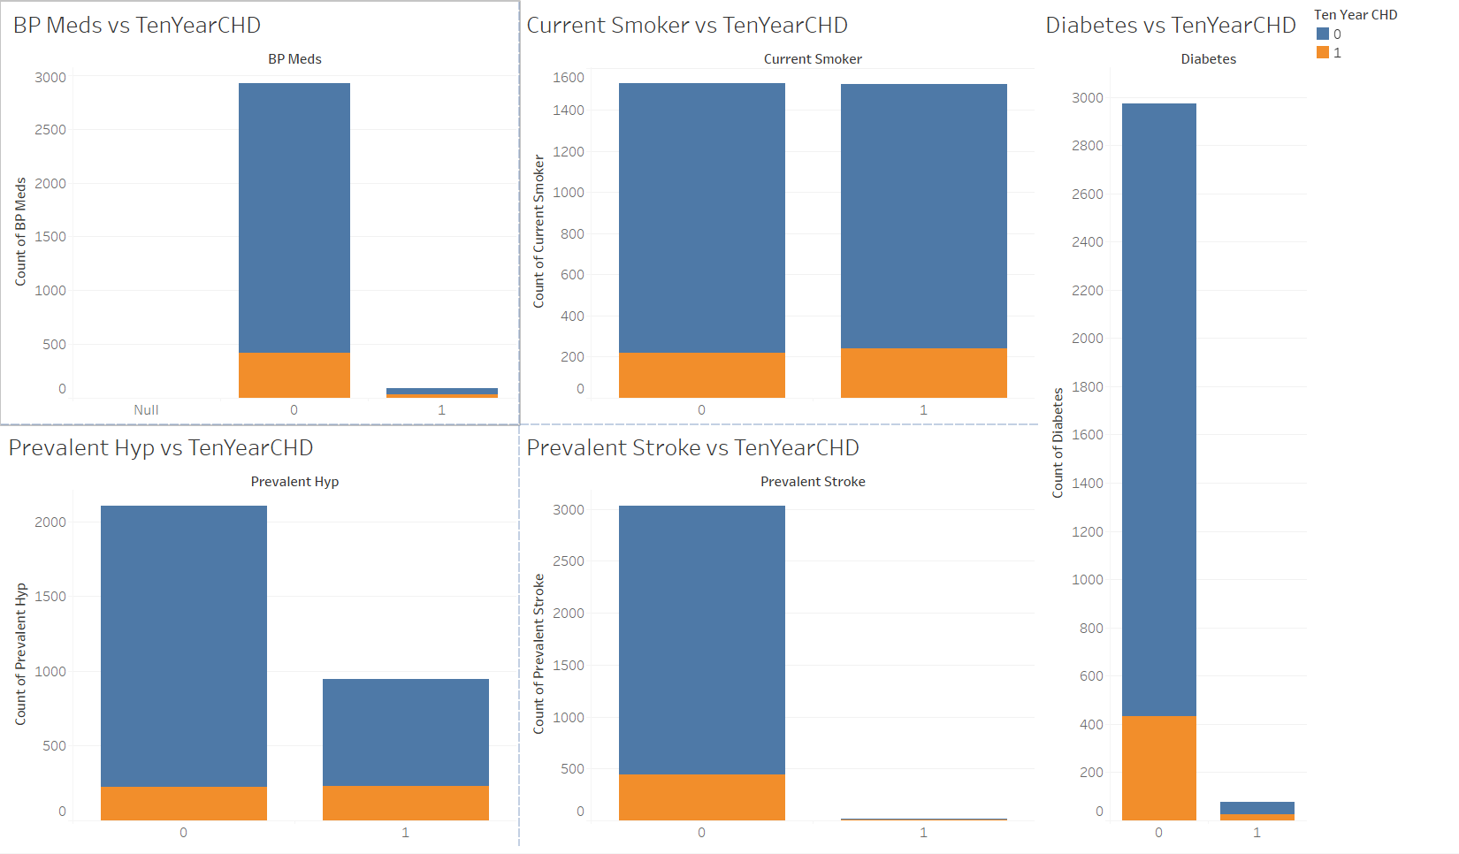
Bivariate Analysis
Categorical Variable vs Response
No significant correlation with response variable
No significant correlation with response variable

Slide 18
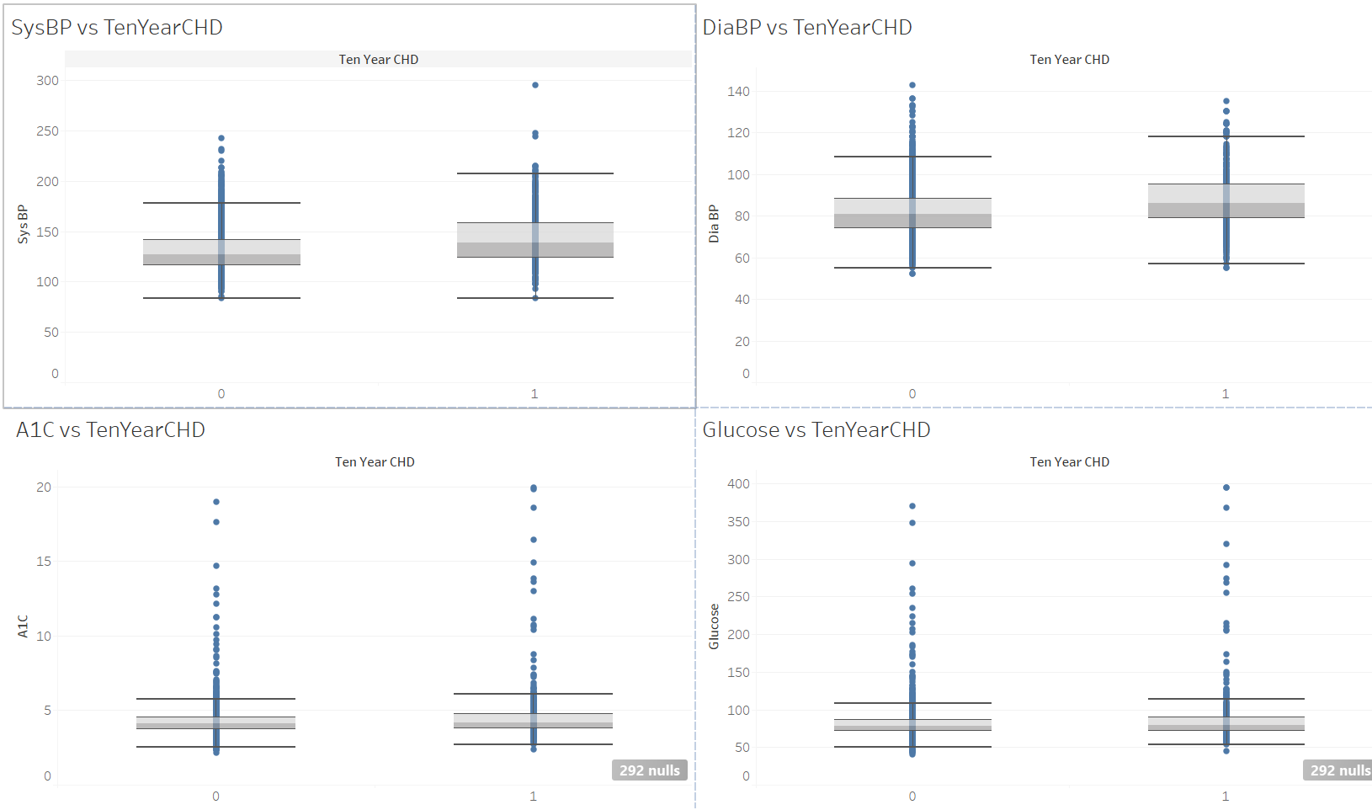
Bivariate Analysis
Numeric vs Response
Heavy outliers and hard to notice correlation

Slide 19
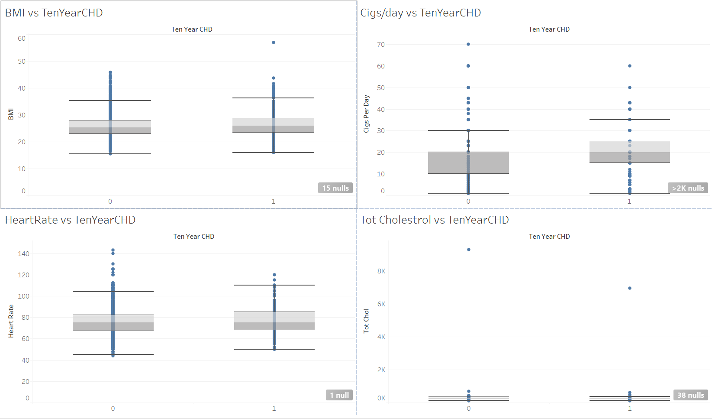
Bivariate Analysis
Numeric vs Response
No significant correlation
Heavy outliers and hard to notice correlation

Slide 20
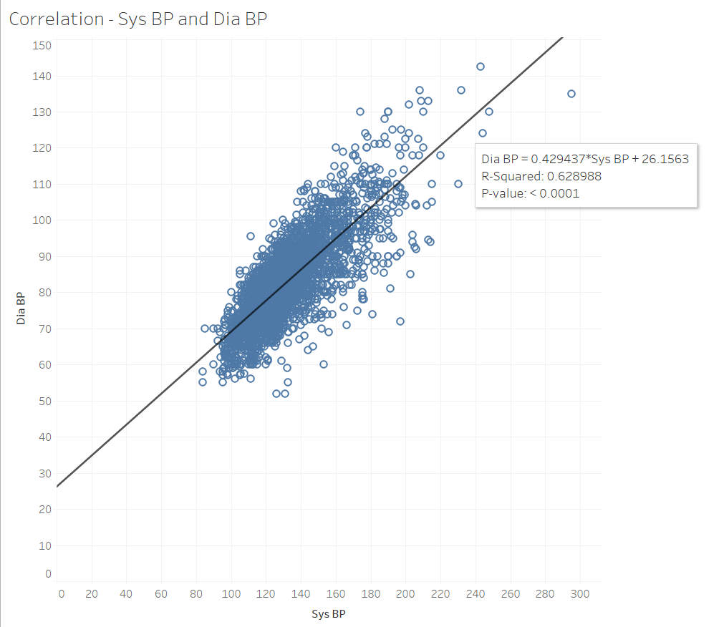
Bivariate Analysis
Correlation Analysis
Moderately correlated.
R2=0.62

Slide 21
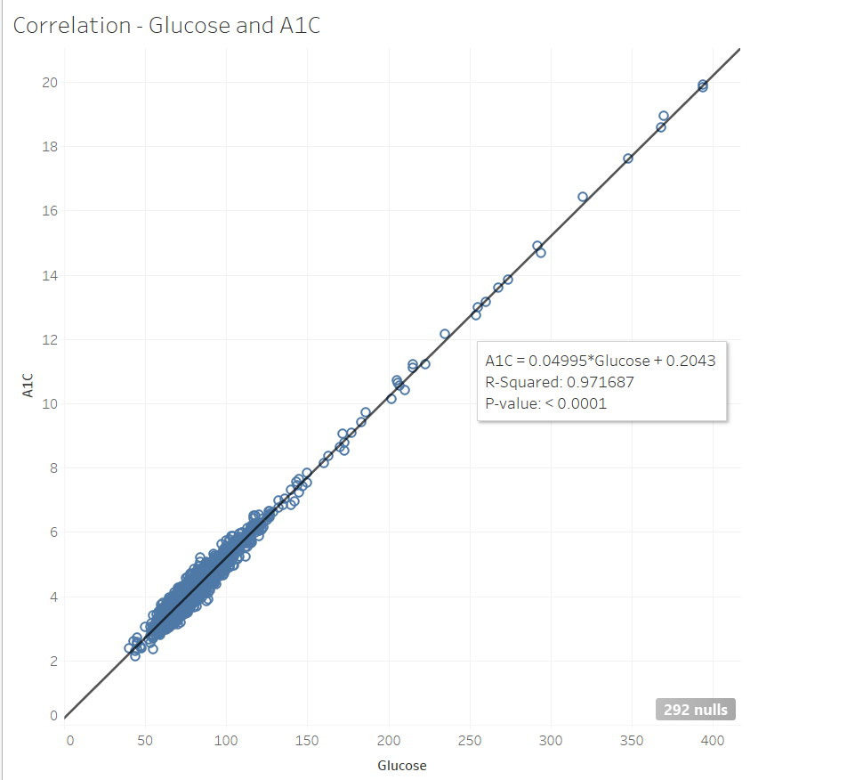
Bivariate Analysis
Correlation Analysis
Highly correlated.
R2 = 0.97
Will discard Glucose and retain A1c. According to prior knowledge, A1c reflects average blood glucose levels over a period of approximately 2 to 3 months

Slide 22
Data Preparation Plan
Overview
Data quality issues and actions
Feature selection decisions
Feature engineering decisions
Dataset partitioning decisions
Dataset split

Slide 23
Data Preparation Plan
Data quality issues and actions
Missing values :
8 variables have missing values:
education : Missing value is replaced by a new value ‘5’ and considered as a separate category.
cigsPerDay
BPMeds
totChol
BMI
heartRate
glucose
a1c
Rest all variables are filled with median

Slide 24
Data Preparation Plan
Feature selection decisions
Drop the following variables:
‘income’
Strong positive skewed variable. Performed log transformation and created a new feature ‘income_log’
‘glucose’
Highly correlated with ‘a1c’ variable

Slide 25
Data Preparation Plan
Feature engineering decisions
Log-transform ‘income’ due to strong positive skew and create a new variable ‘income_log’
Perform one-hot encoding on ‘education’ as it can be treated as nominal feature
Perform Winsorisation to handle outliers on below features. Outliers that exceed the upper bound are replaced with the value at the upper bound, while outliers below the lower bound are replaced with the value at the lower bound.
'a1c', 'cigsPerDay', 'income_log', 'totChol', 'sysBP', 'BMI'
Perform Feature Scaling to standardize the features.

Slide 26
Data Preparation Plan
Dataset partitioning decisions
Perform SMOTE oversampling due to unbalanced dataset on training data

Slide 27
Data Preparation Plan
Dataset SPLIT
“Final Project Dataset.csv” is split into training(80%) and validation dataset(20%) on random_state=42.

Slide 28
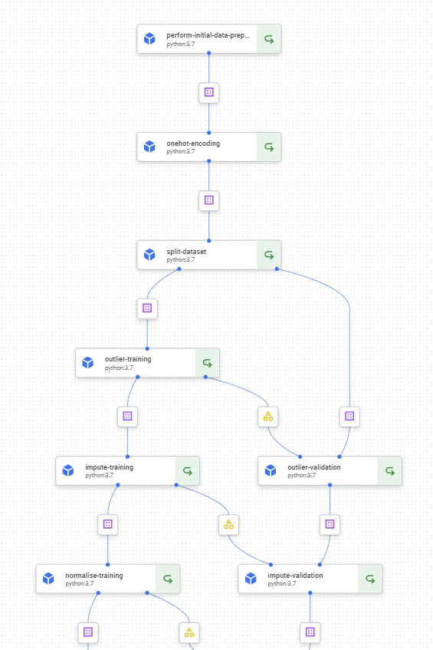
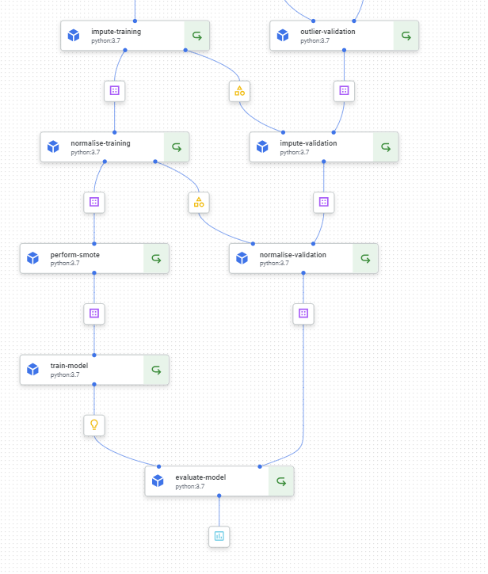
Model Pipeline
Overall Pipeline

Slide 29
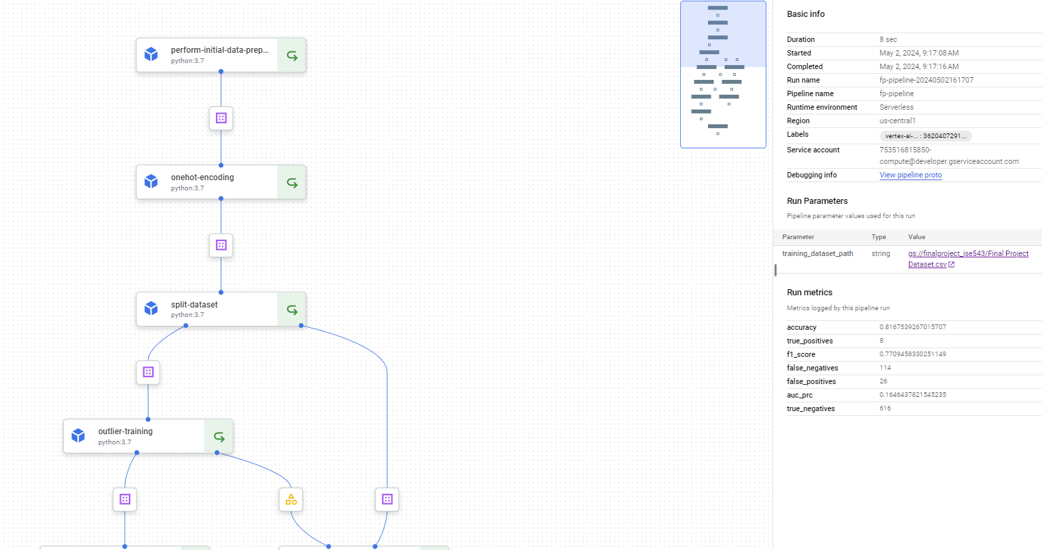
Model Pipeline
Model Evaluation Results

Slide 30
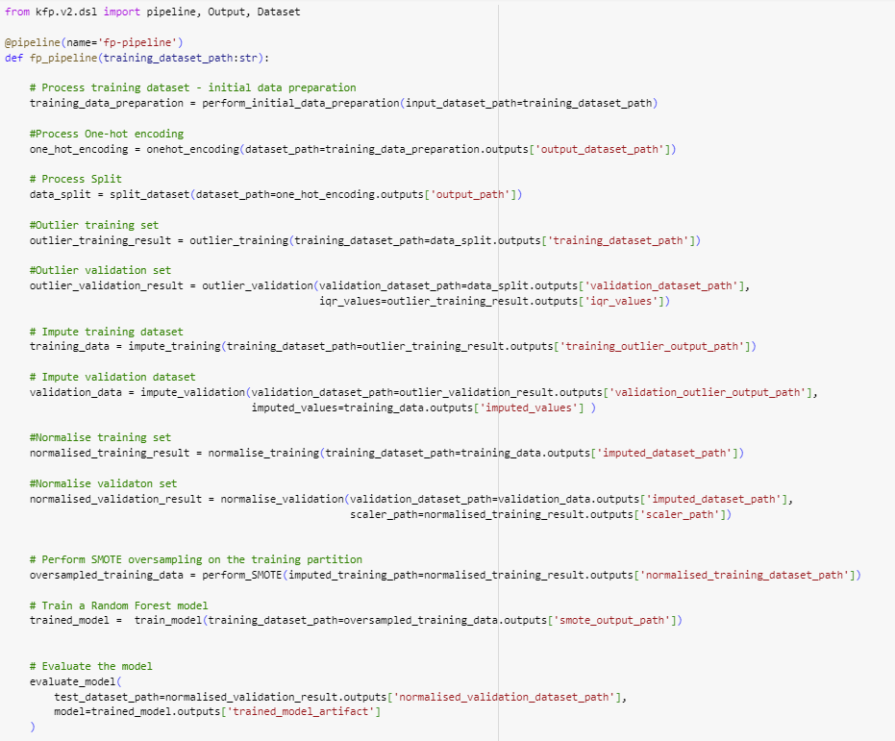
Model Pipeline
Pipeline Definition Code

Slide 31
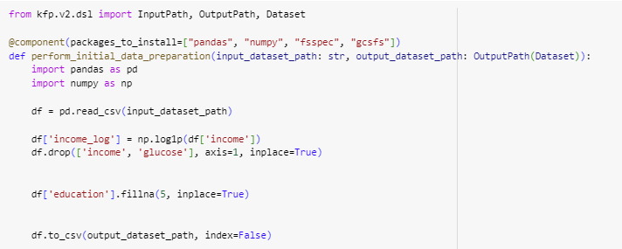
Component Definition
perform_Initial_data_Preparation

Slide 32
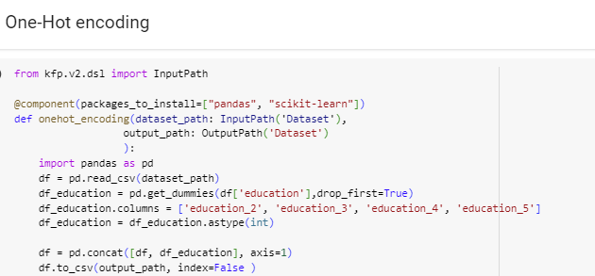
Component Definition
One hot encoding

Slide 33
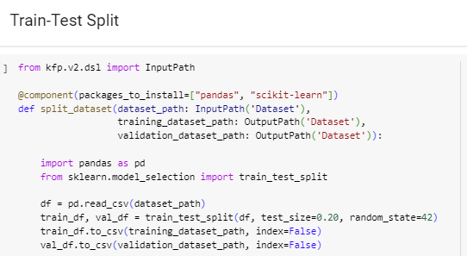
Component Definition
Train-test split

Slide 34
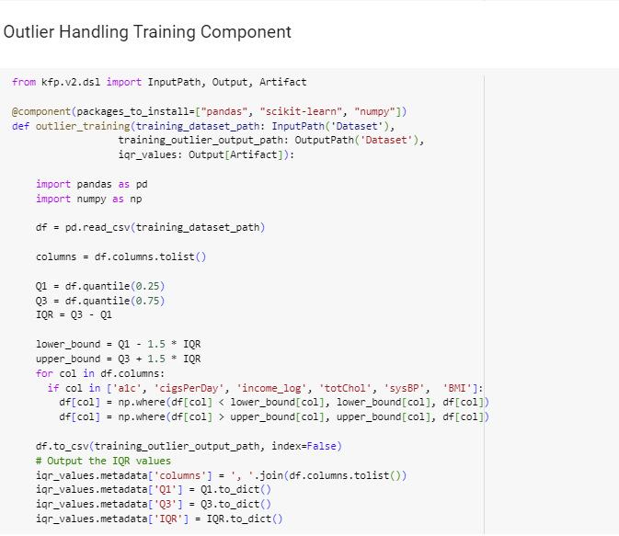
Component Definition
Outlier handling – training dataset

Slide 35
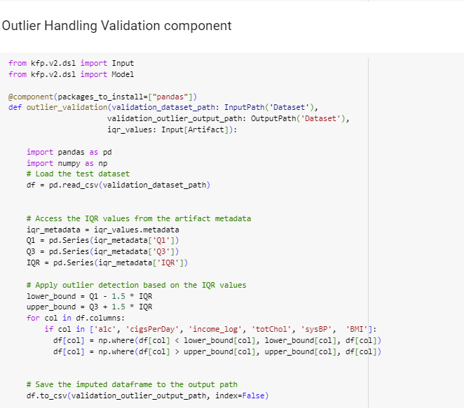
Component Definition
Outlier handling – validation dataset

Slide 36
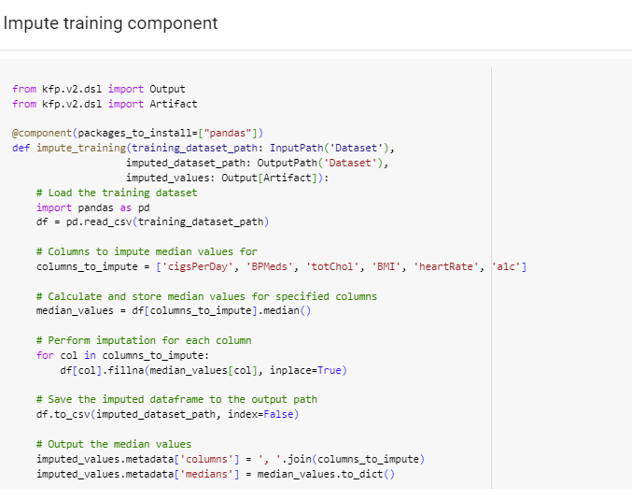
Component Definition
Impute training

Slide 37
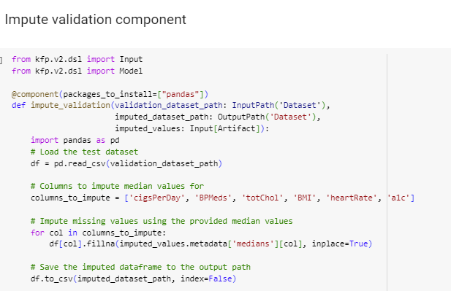
Component Definition
Impute Validation

Slide 38
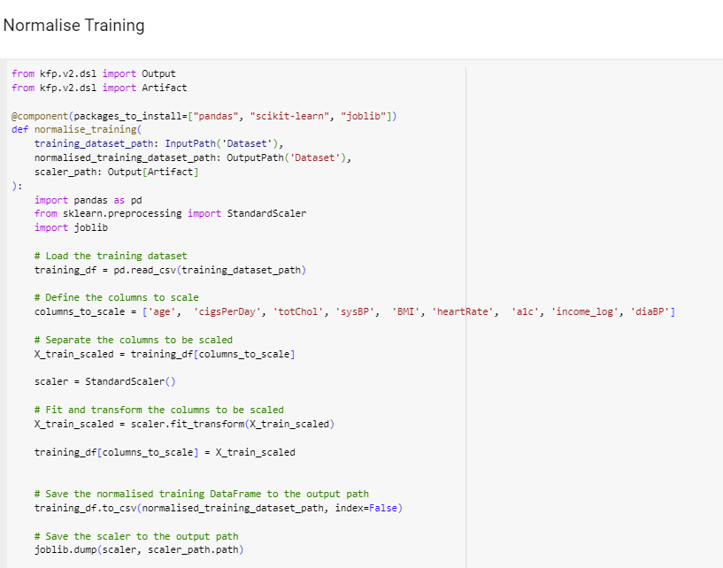
Component Definition
Normalise training

Slide 39
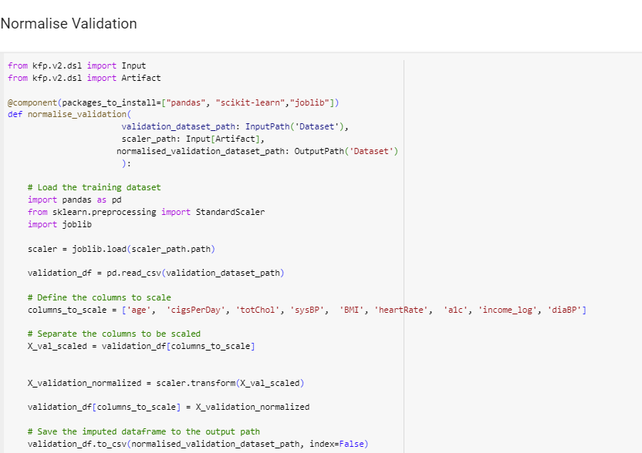
Component Definition
Normalise Validation

Slide 40
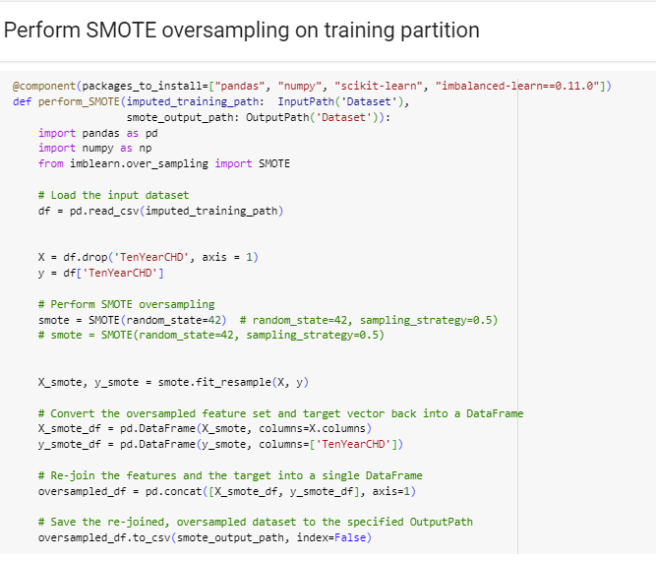
Component Definition
Perform smote

Slide 41
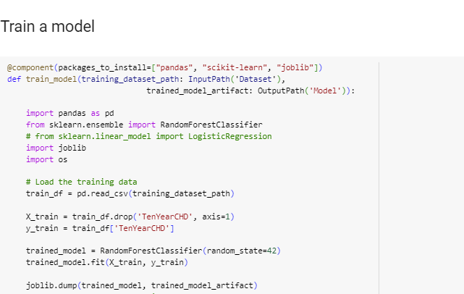
Component Definition
Train Random forest model

Slide 42
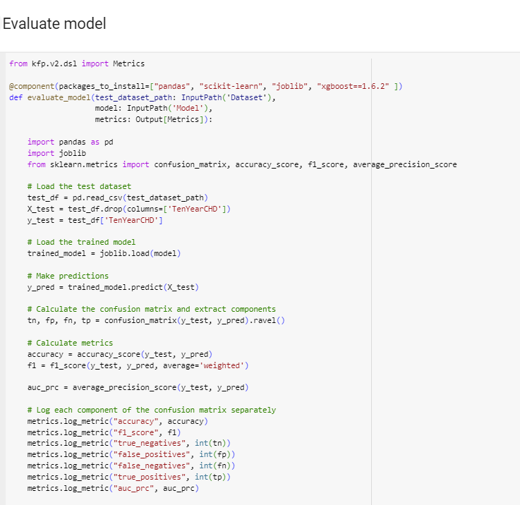
Component Definition
Evaluate model

Slide 43
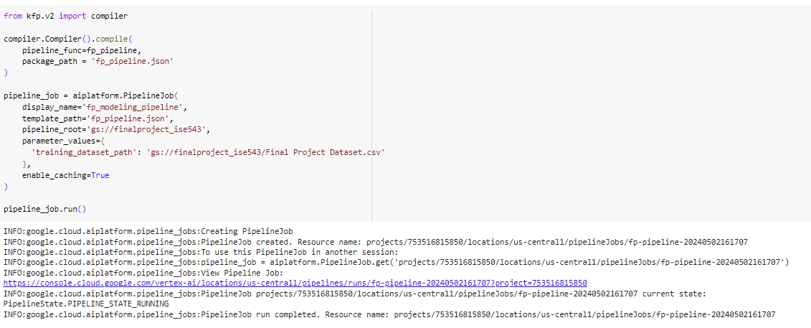
Component Definition
Pipeline compile and run

Slide 44
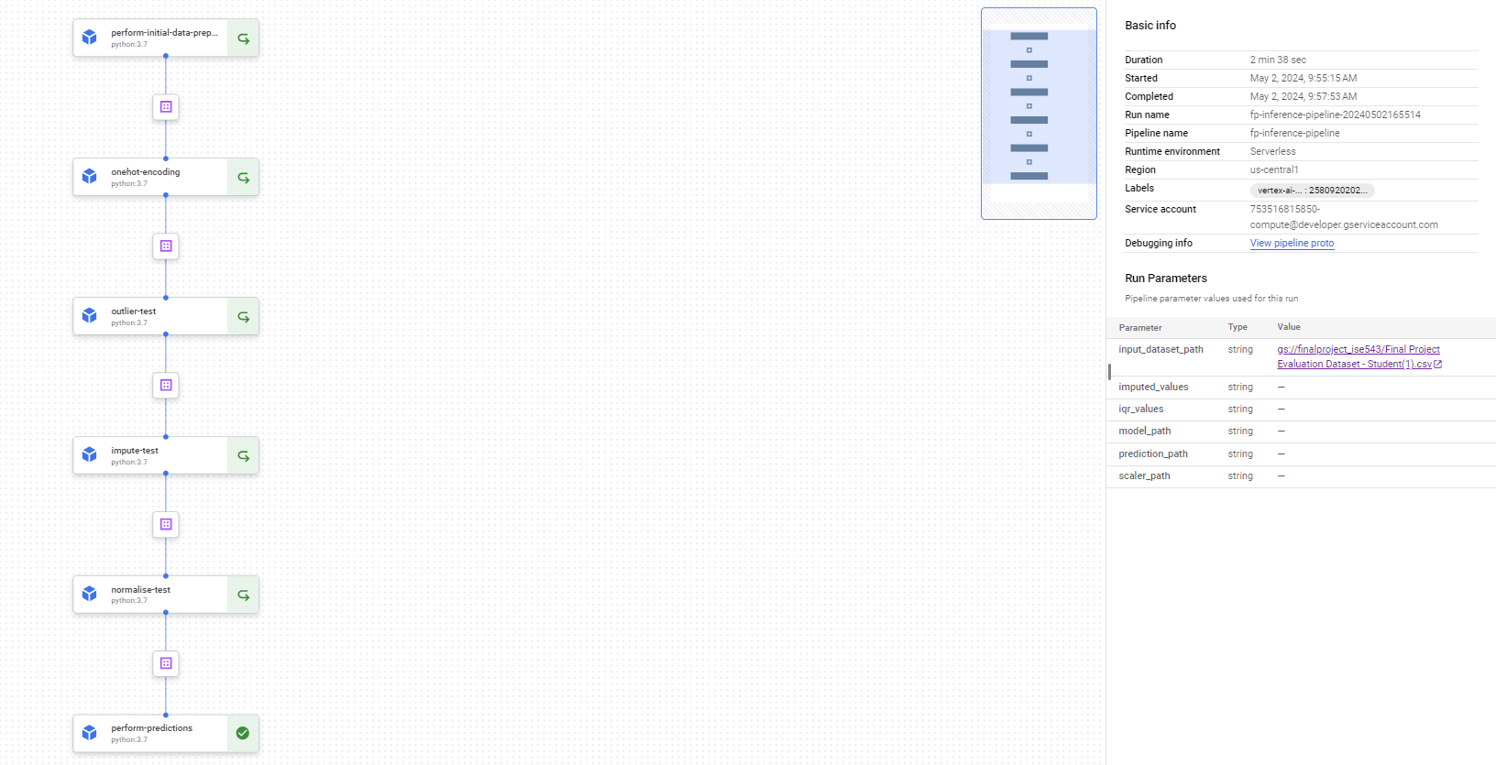
Inference Pipeline
Pipeline Visualization

Slide 45
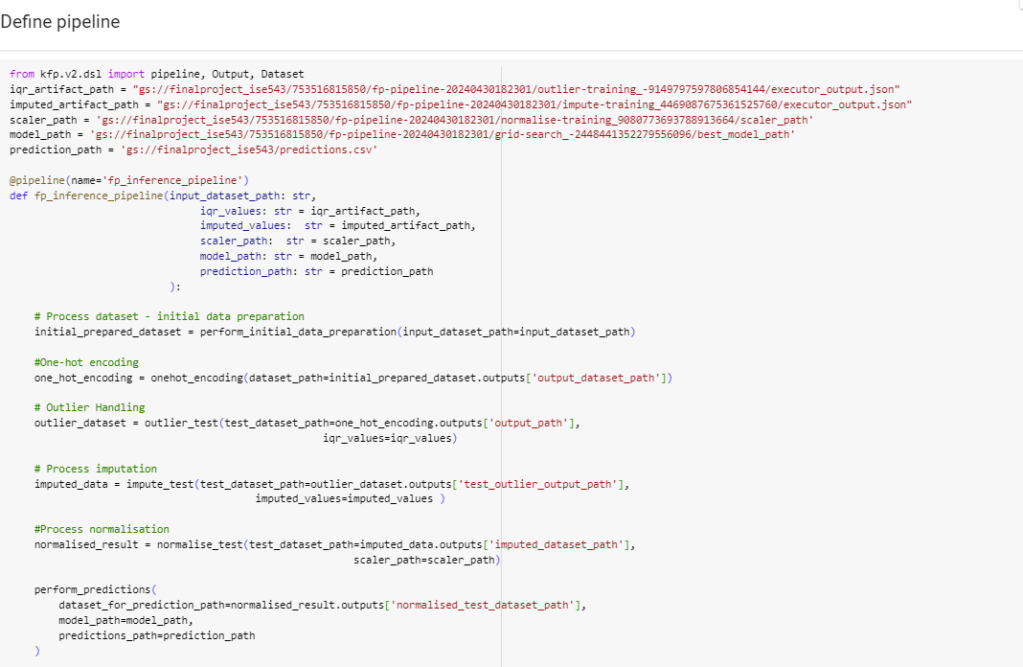
Inference Pipeline
Pipeline Definition

Slide 46
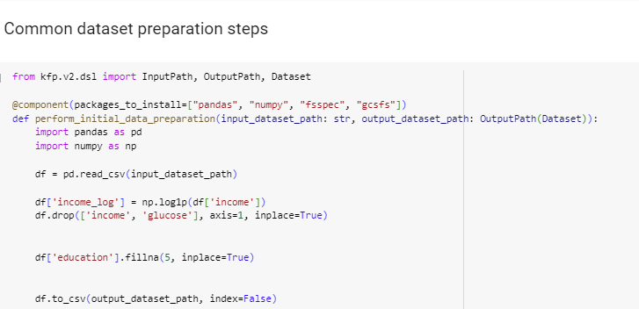
Inference Pipeline
Initial Data Preparation

Slide 47
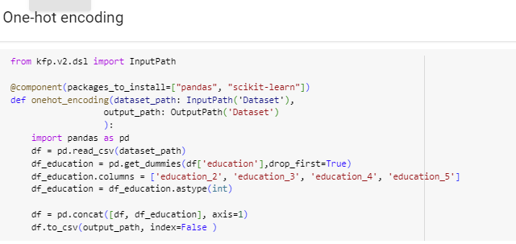
Inference Pipeline
One hot encoding

Slide 48
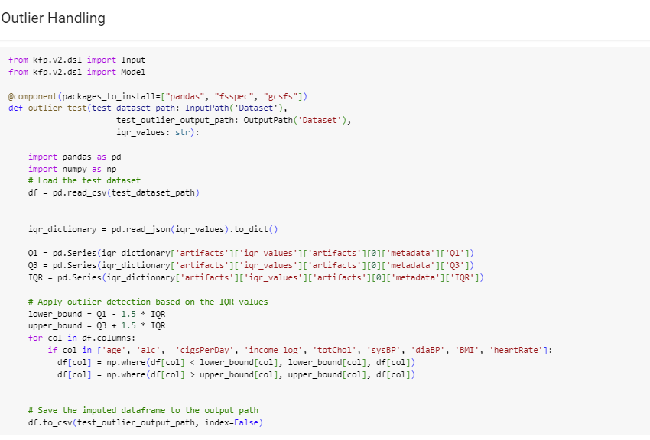
Inference Pipeline
Outlier handling

Slide 49
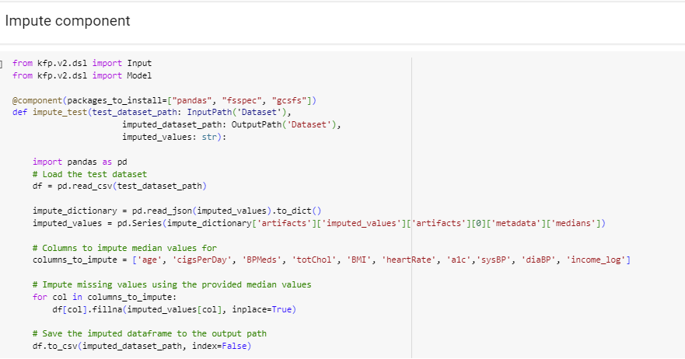
Inference Pipeline
Impute median values

Slide 50
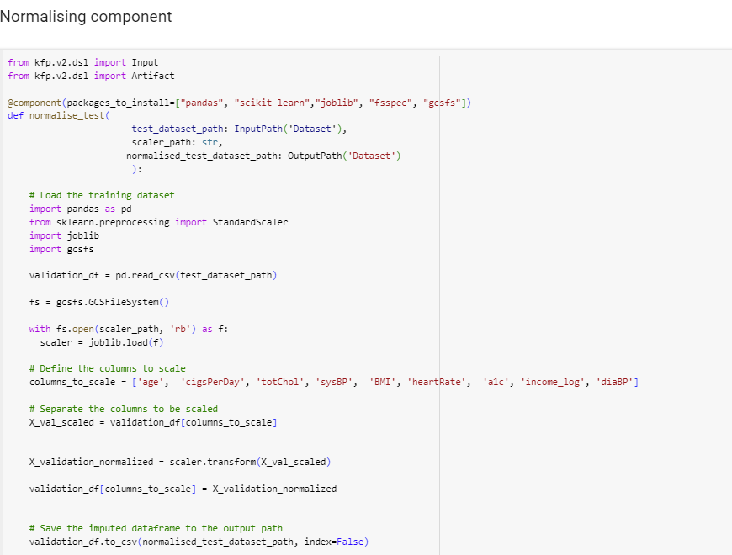
Inference Pipeline
Normalize data

Slide 51
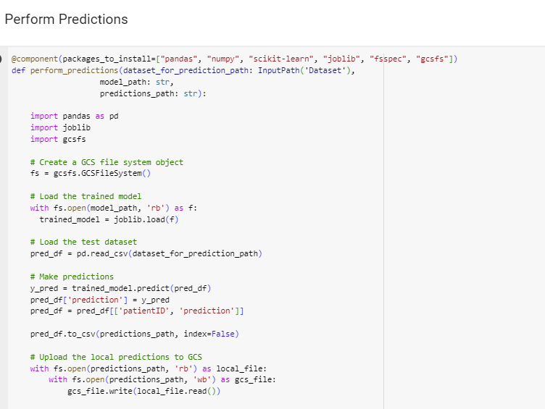
Inference Pipeline
Perform predictions

Slide 52
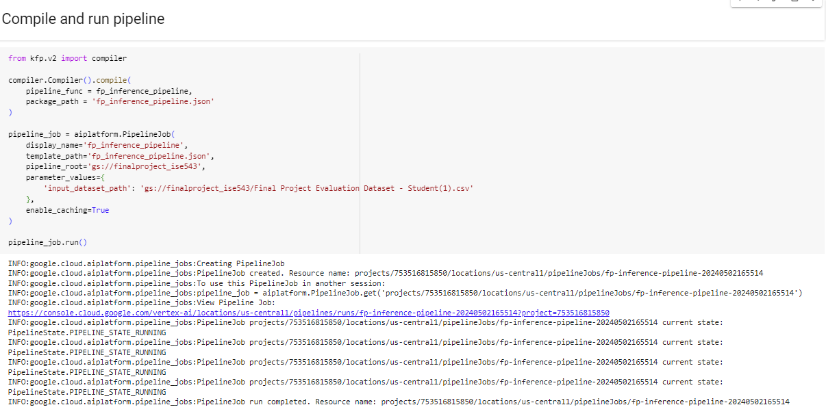
Inference Pipeline
Compile and run pipeline

Slide 53
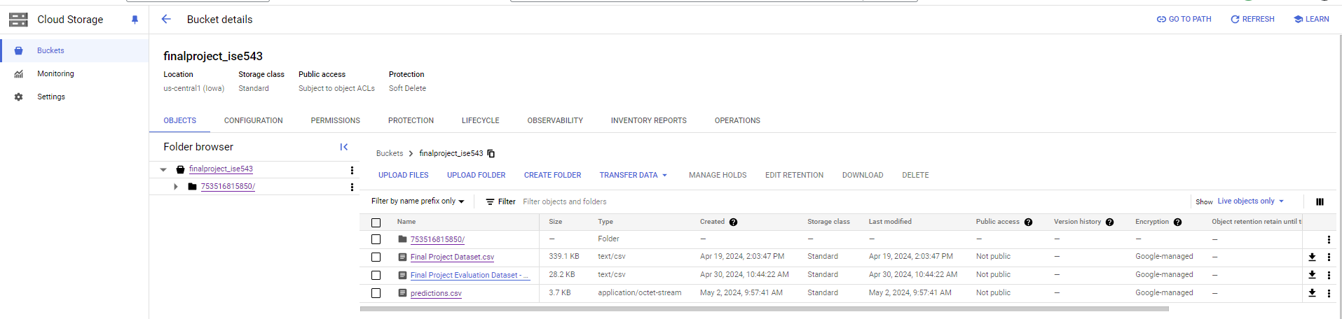
Inference Pipeline
Cloud storage - buckets
Predictions are stored in GCS bucket with the name predictions.csv

Slide 54
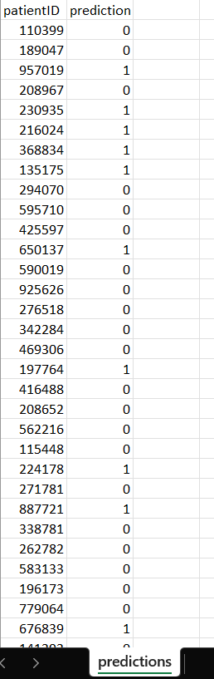
Inference Pipeline
Screenshot of Predictions CSV
Predictions.csv is downloaded from the GCS bucket where all predictions was stored in csv format

Slide 55
Summary Discussion
Feature engineering decisions that improved the model
Handling outliers using Winsorization.
Replacing missing values using median.
Dropping highly correlated and strong skewed feature reduced over fitting.
Performing SMOTE on training data helped with data imbalance.
The Random Forest model appears to be a moderate fit for this dataset
Considering ensemble models like XGBoost, Voting would help to improve generalization and robustness by leveraging the strengths of different models.

